Slide 1

The European Association Medical devices
Notified Bodies
2016
Presentation

Slide 2

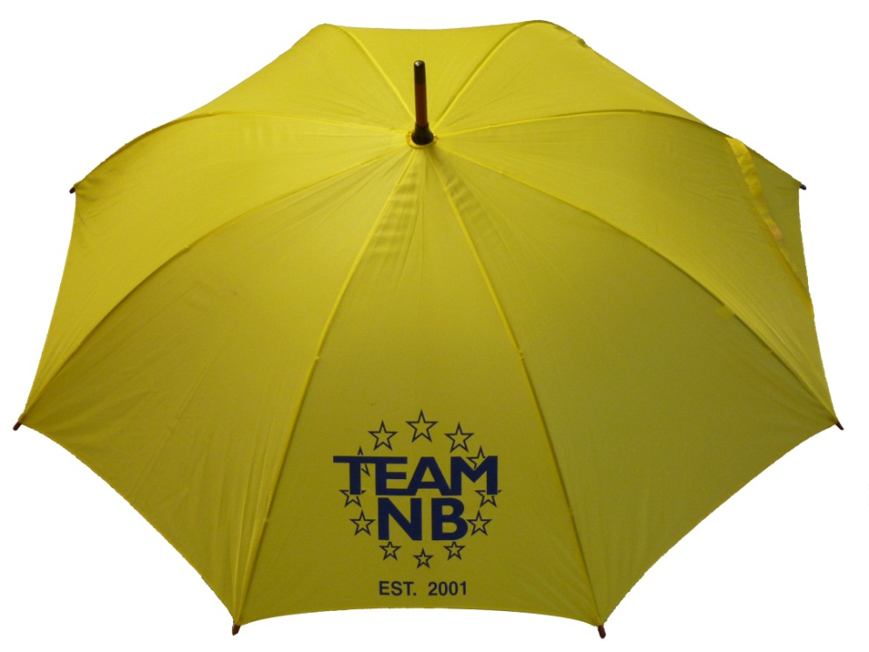
TEAM-NB
Aims:
  Communication with
    European Commission
    Competent Authorities
    Industry
  Promote technical and ethical standards
  Participate in improving the legal framework
  Contribute to harmonization
  Represent Notified Bodies
2016 Presentation

Slide 3
TEAM-NB
Code of Conduct mandatory
2016 Presentation

Slide 4



Context of TEAM-NB
Commission
M
R
A
Switzerland
Canada
Australia
New Zealand
USA
Japan, …
CEN CENELEC
EMA
NB-MED
MDEG
NBRG
NBOG
COEN
Experts Groups
EUDAMED,
IVD,
Vigilance
EUROMContact,
EUCOMED, MedTech,
FIDES, EDMA, EUROM
UEAPME, Eur Assoc of Auth Repr
CPME
CMC
logo
I
M
D
R
F
Health Professionals
Notified Bodies
Manufacturers
Authorised Representatives
Notification
Accreditation
28 Competent Authorities
National Accreditation Bodies
TEAM-NB representatives
2016 Presentation

Slide 5

EUDAMED
European Databank on Medical Devices
(as proposed by the European Commission)
Electronic
system
on
Registration
Medical devices / IVDs
economic operators,
incl.
Summary of Safety
and Clinical
Performance
(high risk devices)
Electronic
system
on
UDI
Device Identifier
data elements
Electronic
system
on
Certificates
Certificates issued
by notified bodies
&
Information on
certificates
refused
suspended
reinstated
restricted
withdrawn
Electronic
system
on
Vigilance
Serious incidents
&
Field safety
corrective actions
&
Field safety notices
Electronic
system
on
Market
surveillance
Measures taken
by Member States re.
devices presenting a
risk to health & safety
preventive health
protection measures
Electronic
system
on
Clinical
investigations
Sponsors
(& manufacturers)
description of:
investigational
device,
comparator,
purpose of CI,
status of CI
NBs need to be able to verify correctiness of economic operators registrations
NBs need to be able to access all UDI data relevant to products they assess
NBs need to be able to add their own data and review data on their certificate holders
NBs need to be able to review vigilance investigations on products they certify
NBs need to be able to provide or review periodic safety update reports (PSUR)
NBs need to be able to verify all data on studies relating products they certify or are assessing
5
2016 Presentation

Slide 6
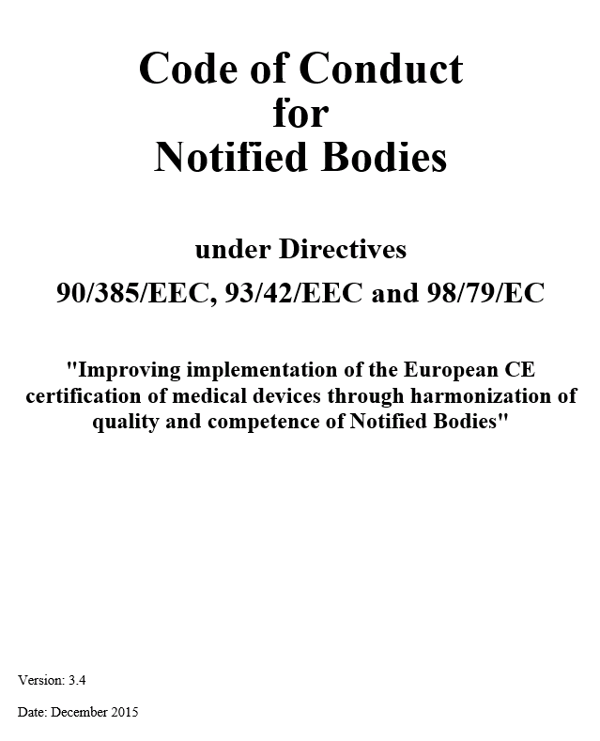
Code of Conduct V 3.4
Mandatory to sign for TEAM-NB members
Available on website www.team-nb.org
New version includes:
  Peer assessment
  Unannounced Visits
  Details on Code of Conduct Compliance Audits by TEAM-NB auditors
Version 3.4 in vote for adoption :
  raising qualification levels
2016 Presentation

Slide 7
Code of Conduct : detailed content
Implementation, enforcement and monitoring of the Code of Conduct
Unannounced visits
Qualification and Assignment of NB Assessment Personnel
Minimum time for Notified Body assessments
Sampling of class IIa and IIb technical files
Design Dossier Reviews
Rules for subcontracting
Rules for Certification Decisions
2016 Presentation

Slide 8

Contacts
Management:
Guy Buijzen (guy.buijzen@dekra.com) – president ad interim
Hans Heiner Junker (hans-heiner.junker@tuev-sued.de) – vice president
Alexey Shiryaev (Alexey.Shiryaev@presafe.com) - treasurer
Corinne Delorme (corinne.delorme@lne.fr) – secretary
Kevin Butcher (kevin.butcher@sgs.com) – CoC board president
Françoise Schlemmer (schlemmer@quasys.com) -Director and Secretariat
www.team-nb.org
2016 Presentation

Slide 9




















Members
2016 Presentation

