Slide 1
The European Association Medical devices
Notified Bodies
Presentation on Web Site
2021
Team-NB Web Presentation 2021

Slide 2
Context of TEAM-NB
COMMISSION : DG SANTE
EMA
MDCG
CEN
CENLEC
NBCG
NBO
Market
Surveillance
Expert groups
EUDAMED
IVD
VIGILANCE
M R A
Switzerland
Canada
Australia
New Zealand
USA
Japan
...
NBTG
CPME
CAMD
AESGP, COCIR, EAAR, EHIMA, EuPC, EUROM,
EUROM VI,
EUROMContact, FIDE,
MedTech Europe
Health
Professionals
Notified Bodies
Manufacturers
Authorised
Representatives
Notification
Accreditation
27 Competent
Authorities
National Accreditation
Bodies
I M D R F
TEAM-NB representatives
2
Team-NB Web Presentation 2021

Slide 3
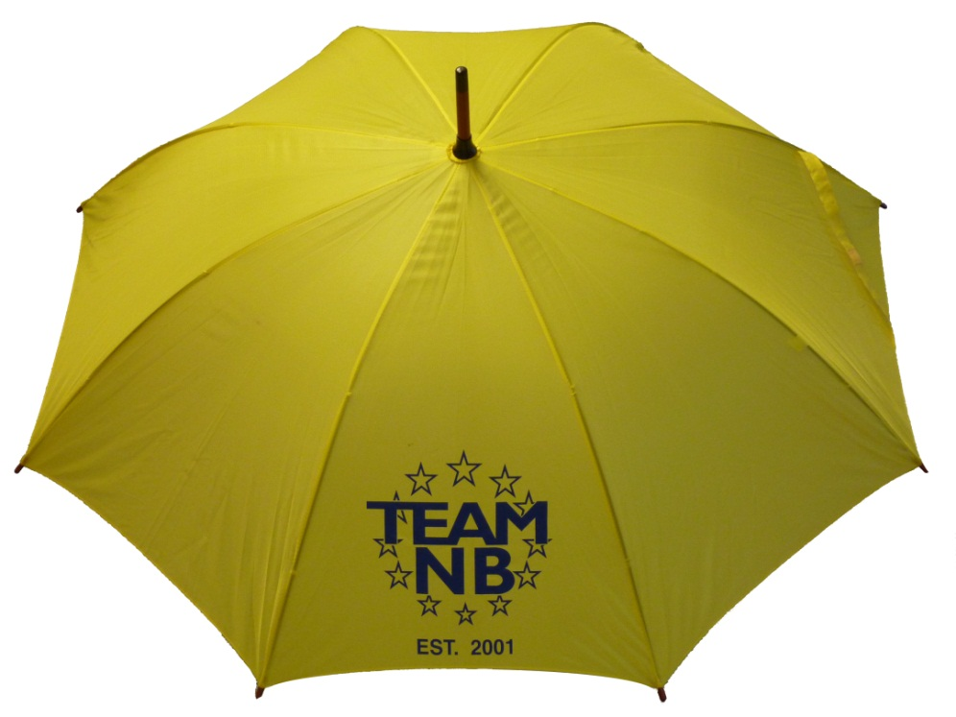
Team-NB
Aims:
Represent Notified Bodies
Communication with
European Commission
Competent Authorities
Industry
Promote technical and ethical standards
Participate in improving the legal framework
Contribute to harmonization (e.g. training ‘for notified bodies by
notified bodies’)
Team-NB Web Presentation 2021

Slide 4
Team-NB
Members over the years
Team-NB Web Presentation 2021

Slide 5
Team-NB
MDR / IVDR designation: TEAM-NB Members versus Designated NBs
Team-NB Web Presentation 2021

Slide 6
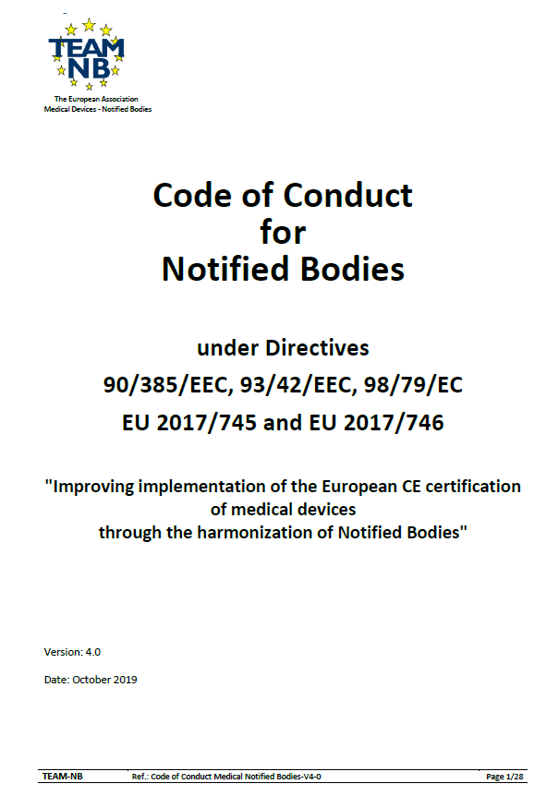
Code of Conduct Version 4
Mandatory to sign for TEAM-NB members
Version 4.0 approved on October 2019
Alignment with MDR / IVDR requirements
Available on website www.team-nb.org

Slide 7
Interpretation of the new regulations
Team-NB established working groups already from April 2016
Aim: formulate an analyse of the new regulations and propose to the members
Procedures to be put in place
To-do lists
…
to be done to submit application for designation and/or wait for implementing acts
Help members to be designated
Allow harmonisation
Classification & Conformity Assessment
NB requirements
Clinical
Vigilance
6
Team-NB Web Presentation 2021

Slide 8
Interpretation of the new regulations
Team-NB established working groups from 2016
Aims
Help members to be designated
Allow harmonization
Team-NB Web Presentation 2021

Slide 9
Implementation of the new regulations
MDCG mirror WGs
Aims
to allow notified bodies members to speak of 1 voice
to prepare and participate in the MDCG meetings
to write reports
distributed to all members
to share information
to comment on MDCG proposals
to write Position Papers (published on Team-NB web site)
Team-NB Web Presentation 2021

Slide 10
Implementation of the new regulations
Task Forces
Aims
to address specific topics of NBs interest
Article 117
TCP III - Taiwan
Transfer Agreement
Standard fees publically available
TOC (table of content)
to write Position Papers (published on Team-NB web site)
to harmonise | views practises
Team-NB Web Presentation 2021

Slide 11
Implementation of the new regulations
Trainings
Aims
to help NBs to deal with new MDR / IVDR requirements in their assessment.
to achieve a better harmonisation among NBs thanks to the exchanges
Team-NB Web Presentation 2021

Slide 12
Implementation of the new regulations
Trainings in 2019
Clinical data: 3 sessions
Trainings in 2020
Clinical data: 1 session
Technical Documentation: 2 sessions in September + 1 Q4
Risk Management: 2 sessions in December
Trainings in 2021
Performance for in vitro diagnostics
Software classification
Team-NB Web Presentation 2021

Slide 13
Transition period
CE mark after "Entry into Application"
Compliance with MDD or AIMD
No significant change in design and intended purpose
Application of the requirements of the Regulations related to
Post-market surveillance, Market surveillance, Vigilance, Registration of economic operators and devices,
NB remains in charge of surveillance
Contract between Manufacturers and NBs
update to be signed to allow surveillance audits
13
Team-NB Web Presentation 2021

Slide 14
Regulation tools
Commission tools
Under the MDCG supervision
Common specifications
New instrument to be adopted by implementing acts which manufacturers will need to apply
Delegated and implementing acts
instrument to precise regulation articles
14
Team-NB Web Presentation 2021

Slide 15
European databank on MD (EUDAMED)
Use of a medical device nomenclature mandatory
Data to be uploaded to collate and process information regarding MD
SRN – single registration number
UDI – unique device identifier -> traceability
aspects of conformity assessment
notified bodies
certificates
clinical investigations
vigilance and market surveillance
15
Team-NB Web Presentation 2021

Slide 16
Contacts
Management:
Alexey Shiryaev (Alexey.Shiryaev@dnvgl.com) – president
Guy Buijzen (guy.buijzen@dekra.com) – treasurer
Gero Viola (gero.viola@de.tuv.com) – secretary
Suzanne Halliday (Suzanne.Halliday@bsigroup.com) – vice president
Sabina Hoekstra-van den Bosch (Sabina.Hoekstra@tuv-sud.nl) – vice president
Françoise Schlemmer (schlemmer@team-nb.org) -Director and Secretariat
www.team-nb.org
16
Team-NB Web Presentation 2021

Slide 17
Members
Team-NB Web Presentation 2021

