Slide 1

The European Association of Medical devices
Notified Bodies
Web Site - Presentation
2026
Copyright © Team-NB Team-NB Web Presentation 2025

Slide 2

Team-NB
Aims:
Represent Notified Bodies
Communication with
European Commission
European Medicines Agency
Competent Authorities
Industry
Others stakeholders
Promote technical and ethical standards
Participate in improving the legal framework
Contribute to harmonization (e.g. training ‘for notified bodies by notified bodies’)

Slide 3
Members
Members over the years from foundation in 2001
45 members representing 19 different countries including new category of NBs: 3 in the designation process

Slide 4

Code of Conduct - Version 5.1
Version 5.1 approved on June 2025 and signed by all Members
Removal of references to Directives and general update of references and terminology
Compliant with MDCG Guidance and TeamNB & NBCG-Med Papers
Estimation of time needed for Technical Documentation review included
Clarified requirements for unannounced audit
Detailed explanation of re-certification requirements
Estimation of time needed for CAPA
Included examples for Structured Dialogue
Enforcement changed to complaint / appeal process
Mandatory to sign for TEAM-NB members
Available on website : www.team-nb.org

Slide 5
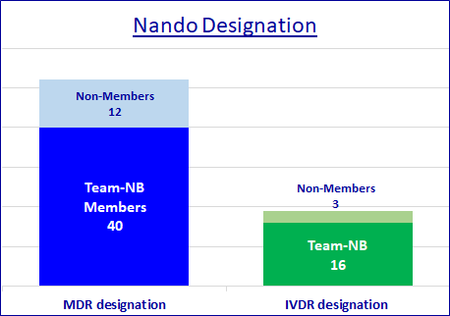
Interpretation of the new regulations
Team-NB established working groups from 2016
Aims
Help members to be designated
Allow harmonization

Slide 6
Implementation of new regulations
MDCG mirror WGs
Aims
to allow notified bodies members to speak of 1 voice
to prepare and participate in the MDCG meetings
to write reports
distributed to all members
to share information
to comment on MDCG proposals
to write Position Papers (published on Team-NB web site)

Slide 7
Implementation of new regulations
Task Forces
Aims
to address specific topics of NBs interest
to write Position Papers (published on Team-NB web site)
to harmonise
BPG 2017-2 Personnel Conformity | Code of ConductCode of Conduct
Assessment | Cybersecurity
Transfer of MDR application | PSUR / CEAR
Medical Gas Systems | Art. 61(10)
Artificial Intelligence | Lifetime
IVDR Harmonisation | …
vues | practises

Slide 8
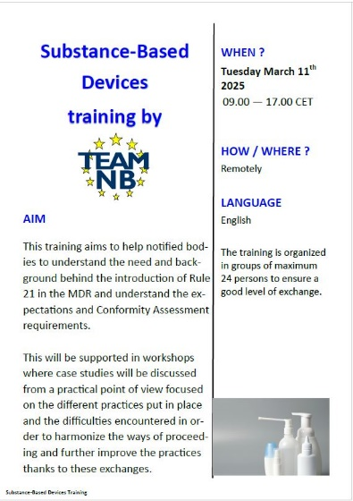
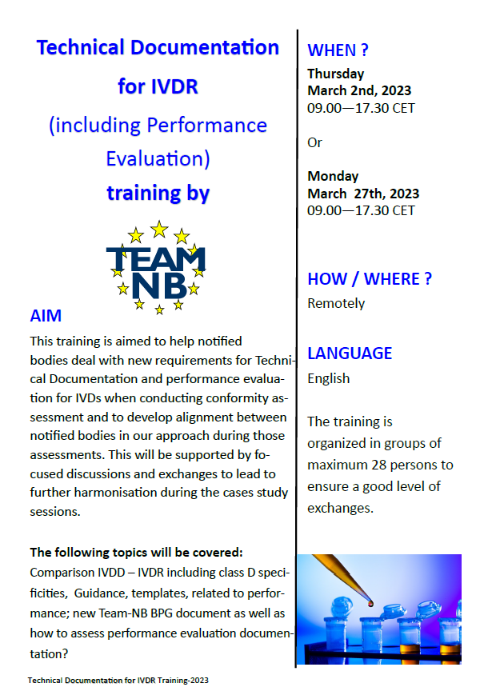

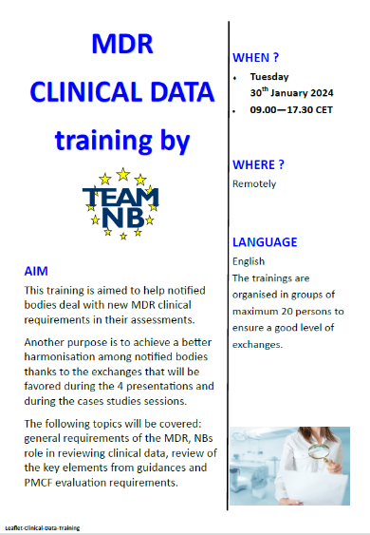
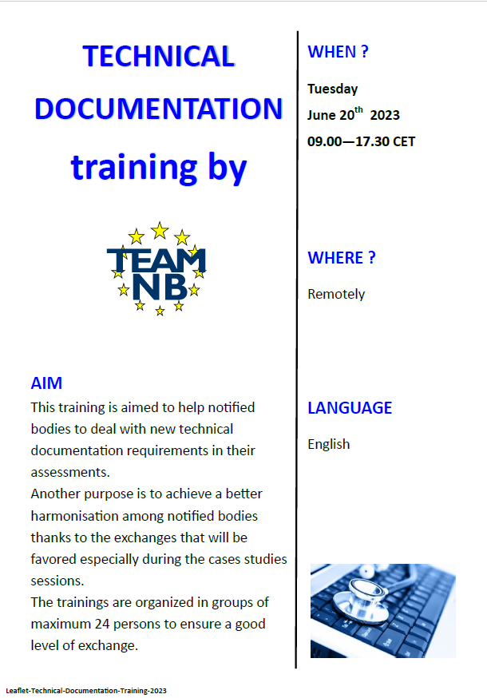

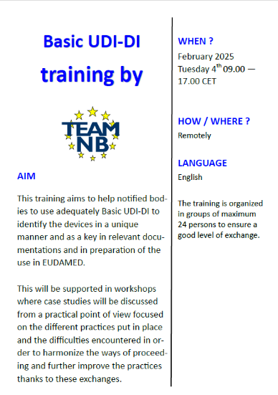
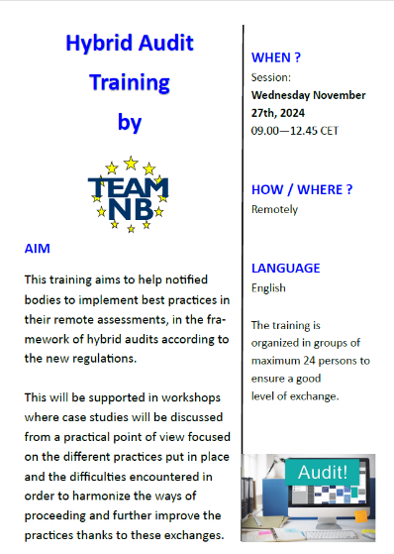

Implementation of new regulations
Trainings
Aims
to help NBs to deal with new MDR / IVDR requirements in their assessment
to achieve a better harmonization among NBs thanks to the exchanges
Trainings Topics
MDR PMS | Code of Conduct
IVDR PMS | Cybersecurity
Basic UDI-DI | MDR Clinical Data
Hybrid Audits | Subtance Based Devices
MDR Software | IVDR Technical Documentaion
MDR Annex XVI | MDR Technical Documentation

Slide 9
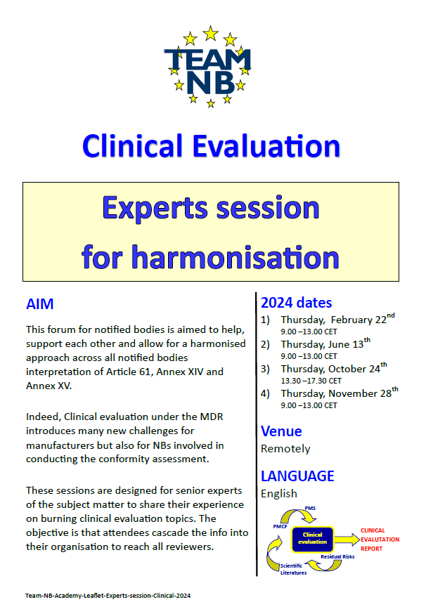
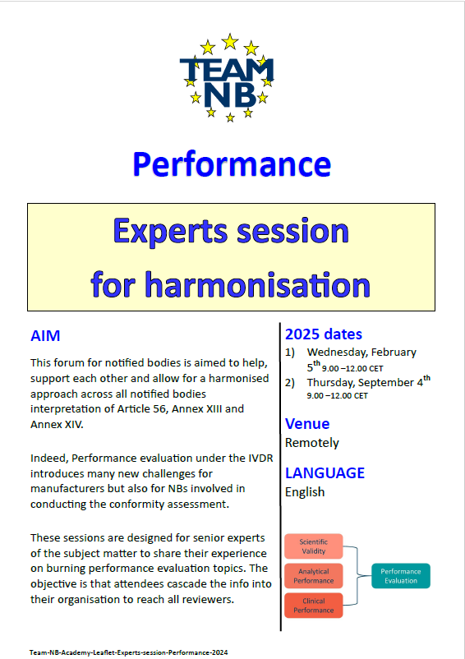
Implementation of new regulations
Experts sessions
Aims
to support NBs
to allow for a harmonised approach across all notified bodies interpretation
for senior experts to share their experience on burning topics
with attendees to cascade the info into their organisation to reach all reviewers

Slide 10
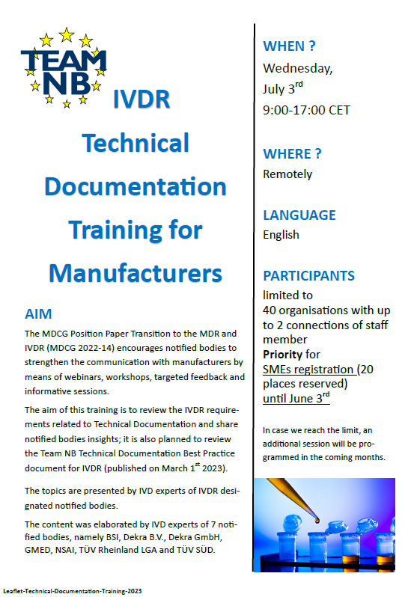
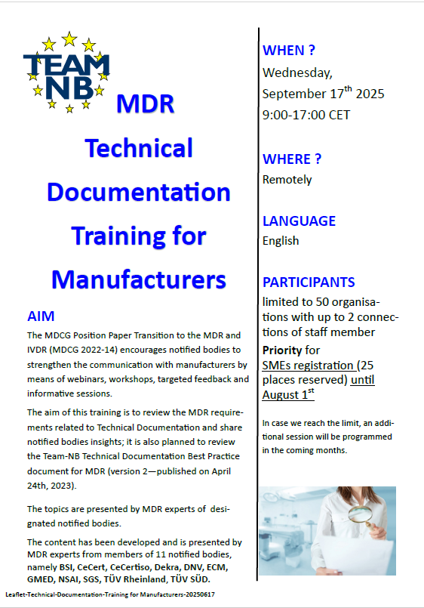
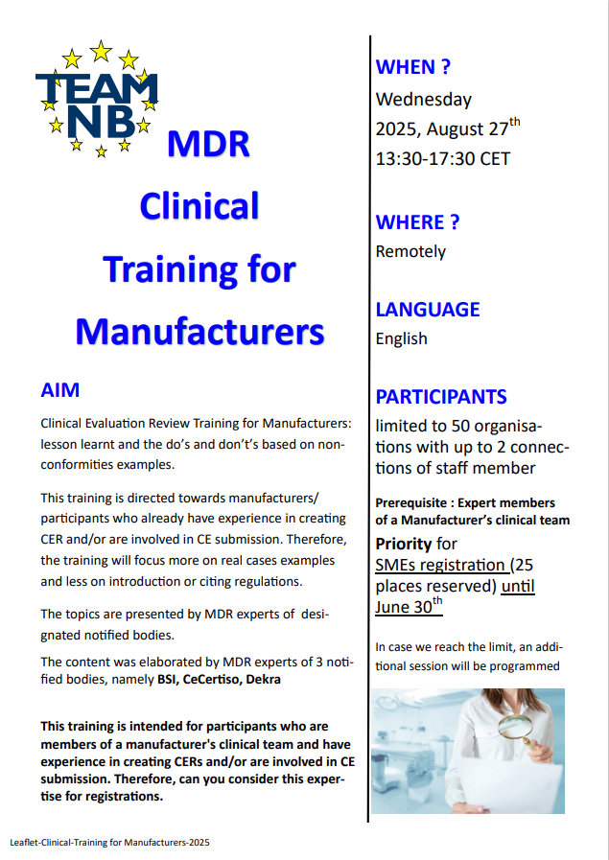
Implementation of new regulations
Trainings for Manufacturers
Aims
to review the IVDR and MDR requirements related to technical documentation and share notified bodies insights
to focus on Clinical requirements of the MDR

Slide 11
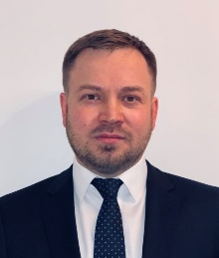
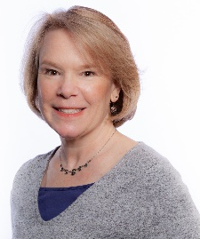
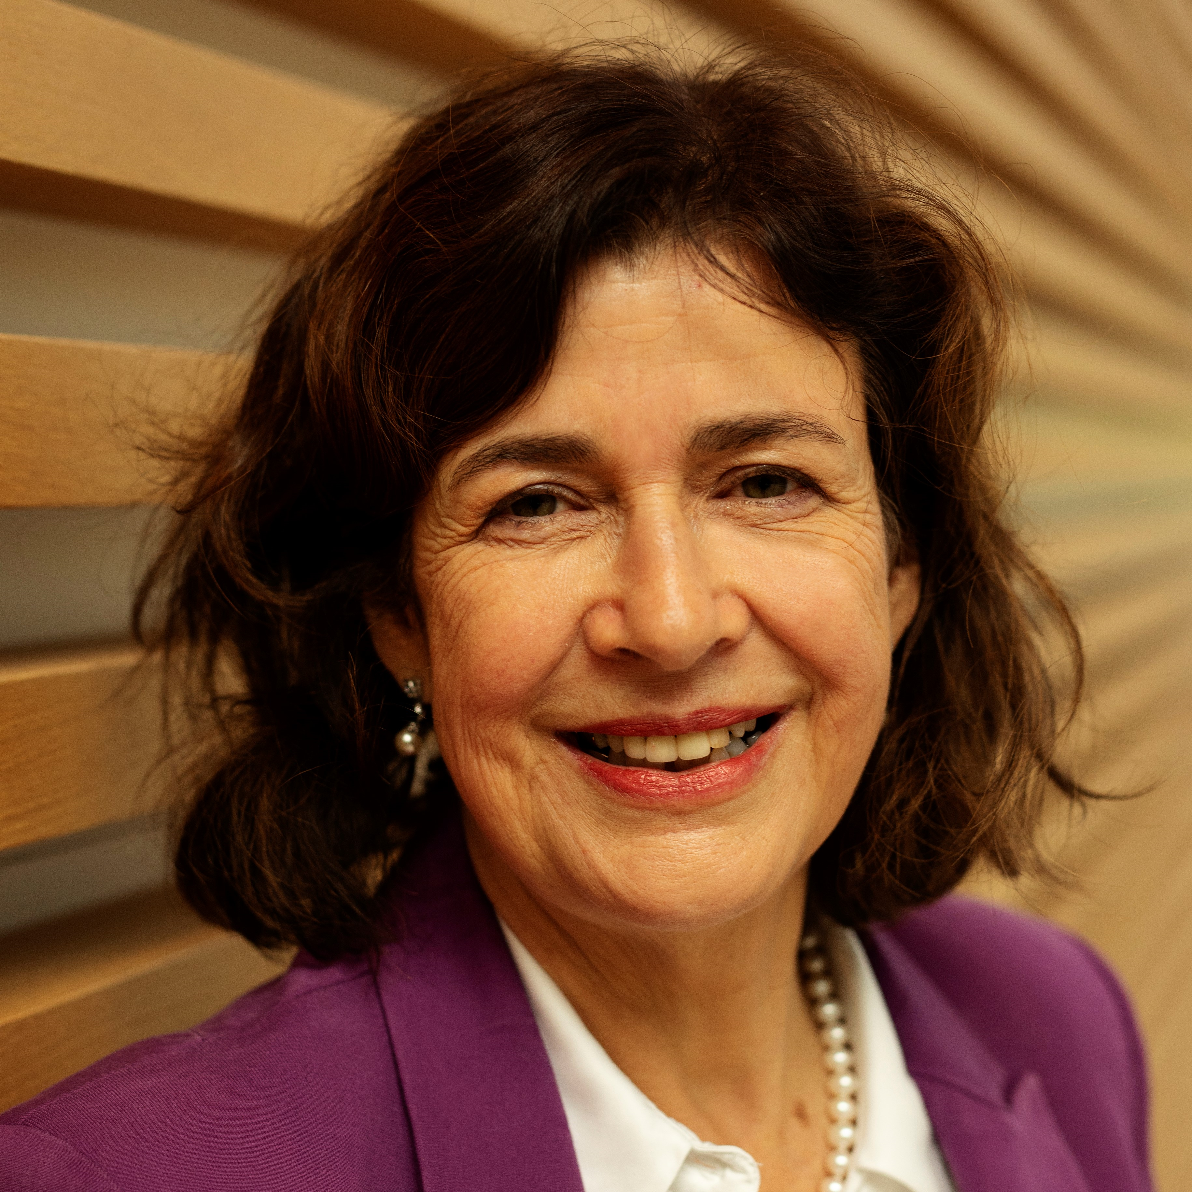
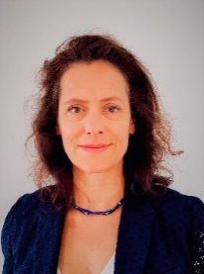
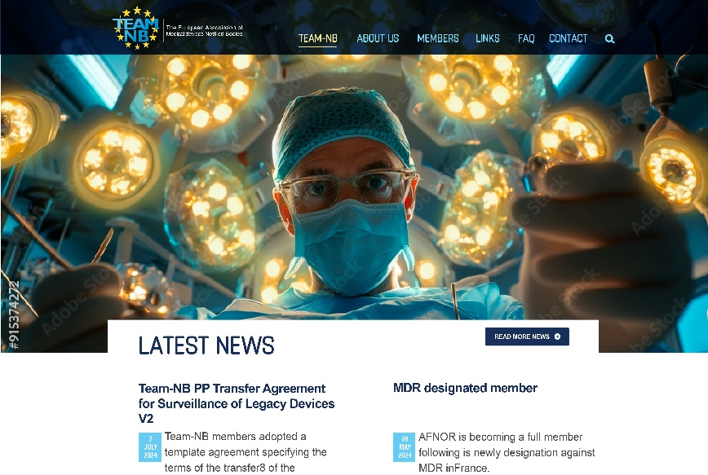
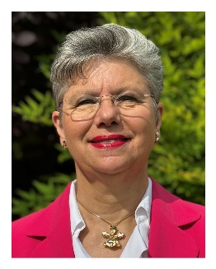
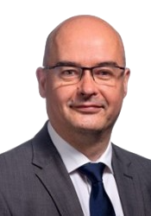
Contacts
Administrative Commitee:
President Alexey Shiryaev | Vice-President Suzanne Halliday | Vice-President Sabina Hoekstra- van den Bosch | Treasurer Heiner Lüdeman | Secretary Béatrice Lys
DNV | BSI | TÜV SÜD | TÜV Rheinland | GMED
Management:
Web site:
www.team-nb.org
Director
Françoise Schlemmer
Deputy Director
Renaud Brendel

Slide 12




































Members
Note : some members of the same group are represented by only 1 logo

