Slide 1

The European Association of Medical devices
Notified Bodies
Presentation
Françoise Schlemmer - TEAM-NB Director
All content on this presentation is subject copyright protection and may therefore not be reproduced (fully or in part), changed, distributed, transmitted, displayed, published, or broadcast without the prior permission of the author/Team-NB
R-Team-NB-Presentation-Brief

Slide 2
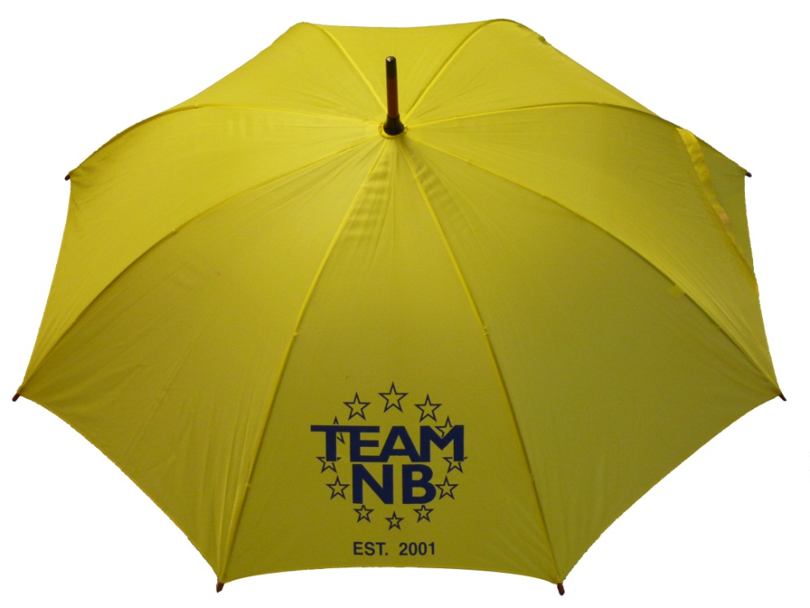
Team-NB
Aims:
  Represent Notified Bodies
  Communication with
    European Commission
    European Medicines Agency
    Competent Authorities
    Industry
    Others stakeholders
  Promote technical and ethical standards
  Participate in improving the legal framework
  Contribute to harmonization (e.g. training ‘for notified bodies by notified bodies’)

Slide 3
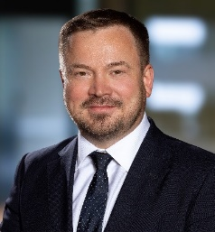
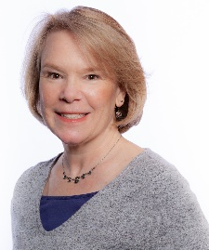
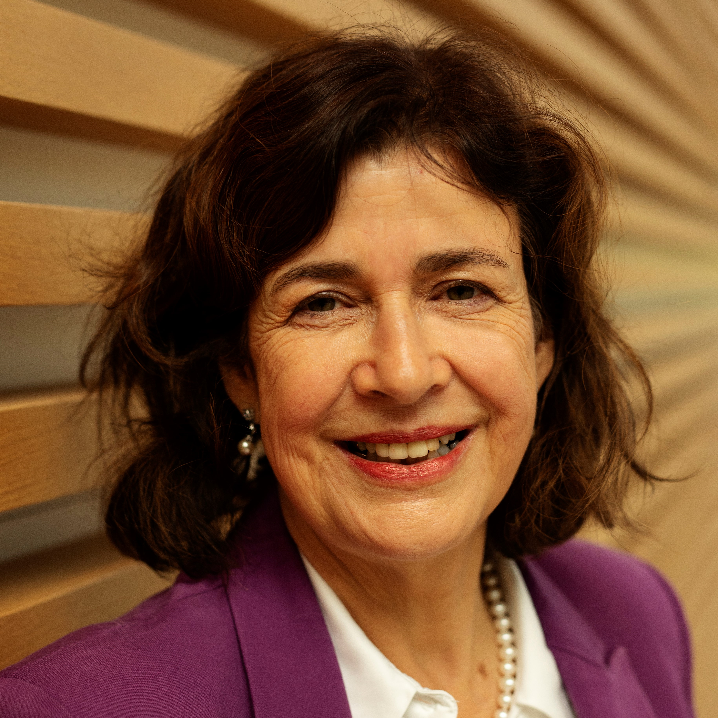
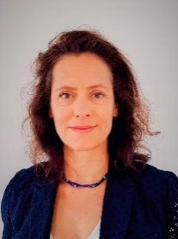
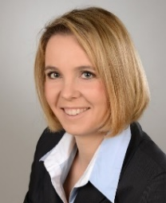
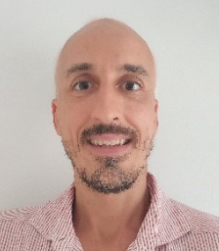
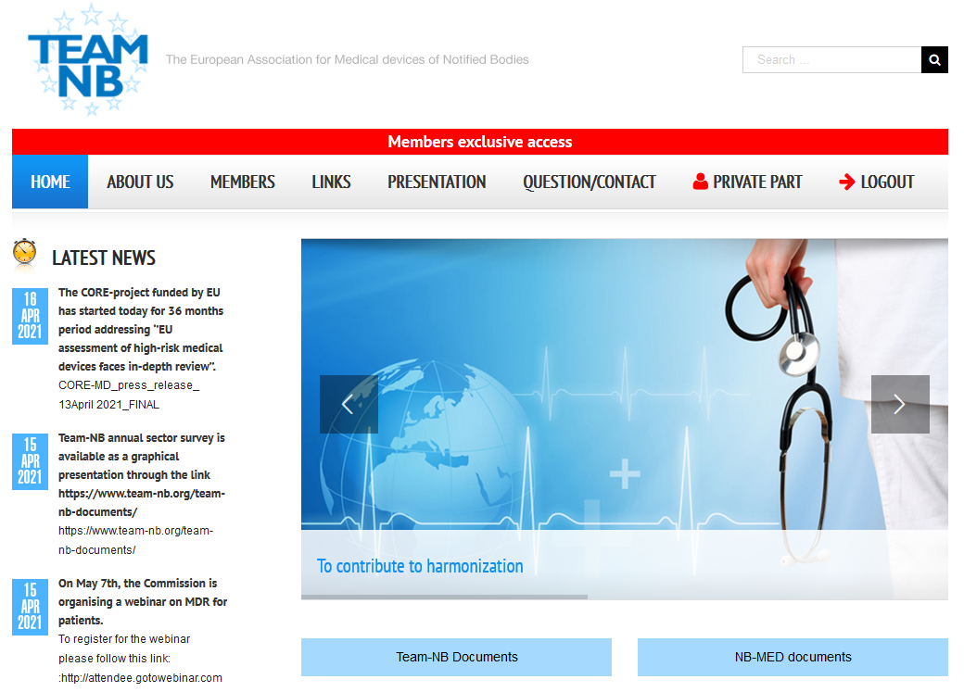
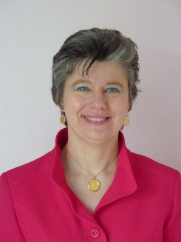
Contacts
Administrative Commitee:
President Alexey Shiryaev | Vice-President Suzanne Halliday | Vice-President Sabina Hoekstra- van den Bosch | Treasurer Daniele Bollati | Secretary Béatrice Lys | Secretary Elke Bess
DNV | BSI | TÜV SÜD | IMQ S.p.A | GMED | TÜV Rheinland
Management:
Web site:
www.team-nb.org
Director Françoise Schlemmer

Slide 4
Members
Members over the years from foundation in 2001 mettre à jour
  43 members representing 20 different countries
  including new category of NBs: 4 in the designation process

Slide 5
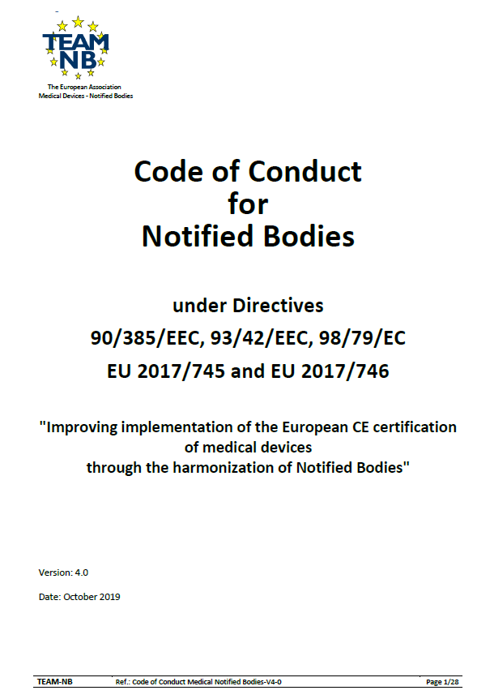
Code of Conduct - Version 4
Mettre à jour Mandatory to sign for TEAM-NB members
Version 4.0 approved on October 2019
Alignment with MDR / IVDR requirements
Available on website www.team-nb.org

Slide 6
Interpretation of the new regulations
Team-NB established working groups from 2016
  Aims
  Help members to be designated
  Allow harmonization

Slide 7
Implementation of new regulations
MDCG mirror WGs
  Aims
  to allow notified bodies members to speak of 1 voice
  to prepare and participate in the MDCG meetings
  to write reports
    distributed to all members
    to share information
  to comment on MDCG proposals
  to write Position Papers (published on Team-NB web site)

Slide 8
Implementation of new regulations
Task Forces
  Aims
  to address specific topics of NBs interest
    AI & Mobile-App
    B&C Rules-NBs-interpretation (rules 8, 11, 14, 21, …)
    Lifetime
    Dental Implants (update of an existing PP)
    Consensus document for MDR applications
  to write Position Papers (published on Team-NB web site)
  to harmonise
    views
    practises

Slide 9
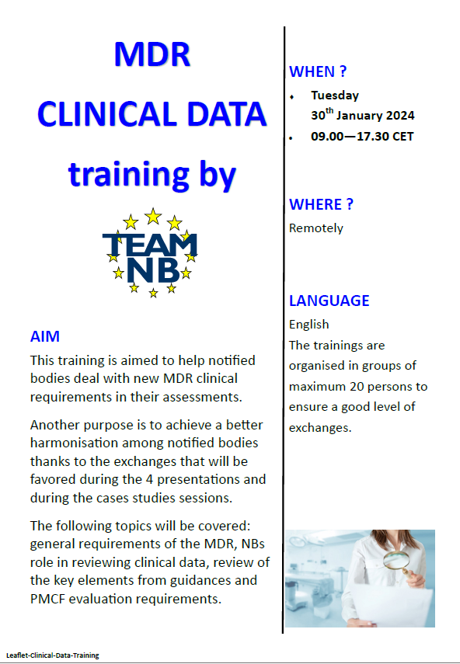
Implementation of new regulations
Trainings
  Aims
  to help NBs to deal with new MDR / IVDR requirements in their assessment.
  to achieve a better harmonisation among NBs thanks to the exchanges

Slide 10
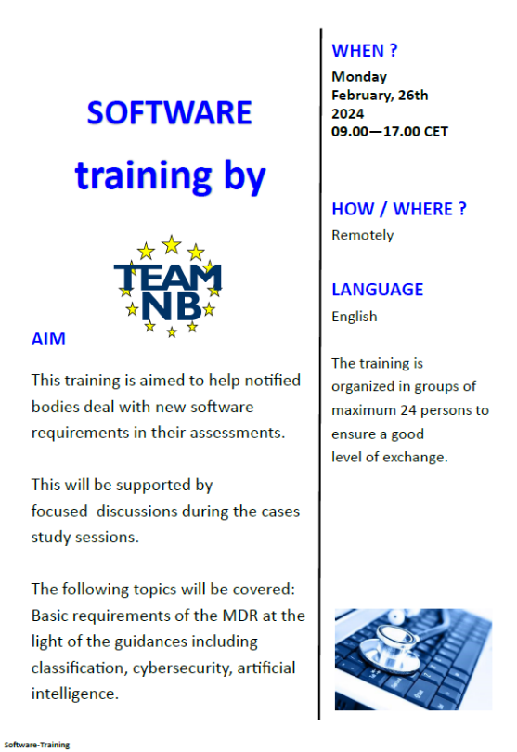
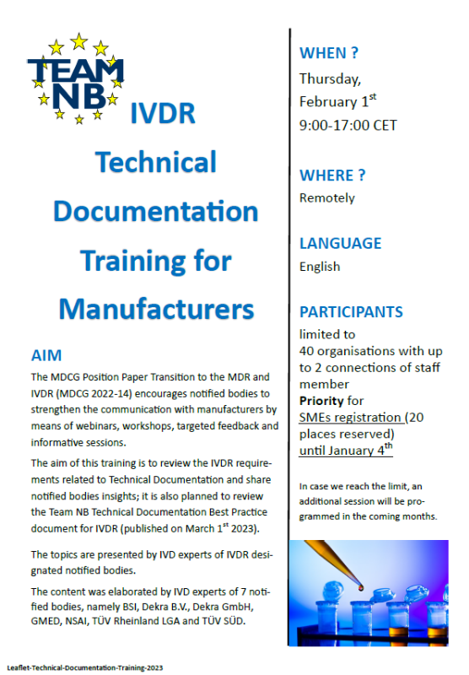

Implementation of new regulations
From 2019
  Clinical data: 3 sessions
To topics Trainings in 2024
Trainings in 2023
  MDR Technical Documentation : 2 sessions
  MDR Software : 1 session
  IVDR Technical Documentation : 2 sessions
  MDR Clinical Data : 2 sessions
  MDR PMS requirements : 2 sessions
  Risk Management : 1 session
  IVDR Technical Documentation Training For Manufacturers : 2 sessions
  MDR Technical Documentation Training For Manufacturers : 2 sessions
Trainings in 2024
  MDR Clinical data : 1 session
  MDR Software : 1 session
  IVDR Technical Documentation Training For Manufacturers : 1 session
  MDR Technical Documentation Training For Manufacturers : 3 sessions

Slide 11
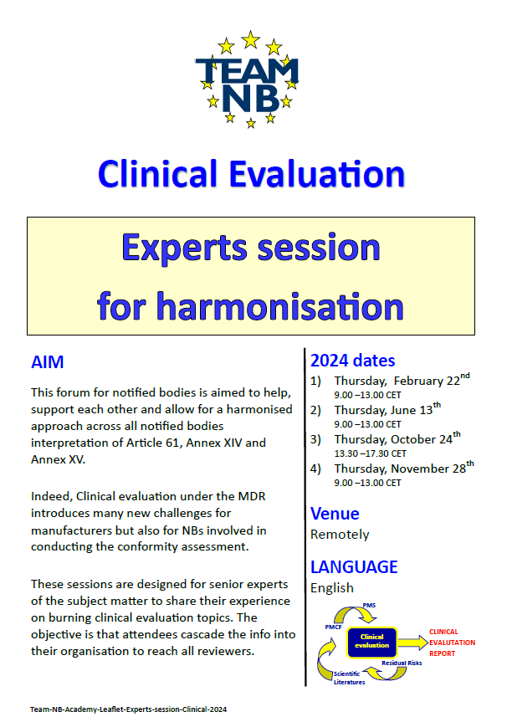
Implementation of new regulations
Experts sessions
  Aims
  to support NBs
  To allow for a harmonised approach across all notified
  bodies interpretation
  for senior experts to share their
  experience on burning topics
  with attendees to cascade the info into their organisation to
  reach all reviewer

Slide 12
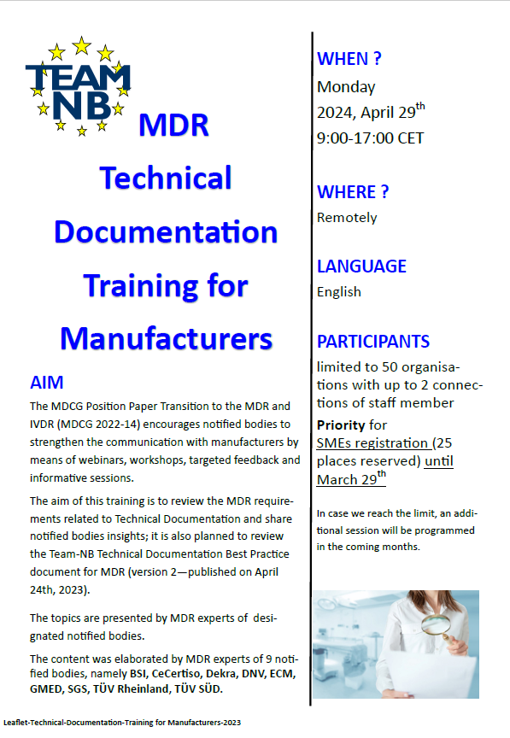
Implementation of new regulations
Trainings for Manufacturers
  Aims
  to review the MDR requirements related to technical documentation and share notified bodies insights
  to review the Team-NB technical documentation best practice document for MDR

Slide 13
Contacts - Management
Alexey Shiryaev (Alexey.Shiryaev@dnv.com) – president
Suzanne Halliday (Suzanne.Halliday@bsigroup.com) vice president
Sabina Hoekstra-van den Bosch
(Sabina.Hoekstra@tuvsud.com)– vice president
Beatrice LYS (Beatrice.Lys@lne-gmed.com) –secretary
Gero Viola (gero.viola@de.tuv.com) – treasurer
Françoise Schlemmer
(schlemmer@team-nb.org)
Director and Secretariat
    www.team-nb.org

Slide 14


































Members
Note : some members of the same group are represented by only 1 logo

